Slide 1
Car Rental System
Eyad Al-Moaid 22321363
Hasan Amer 22324331

Slide 2
What is our project about?
It’s a system that help the user check if a certain car is available for rent using local DB.
After checking the database the program sends the status of the chosen car to the user.

Slide 3
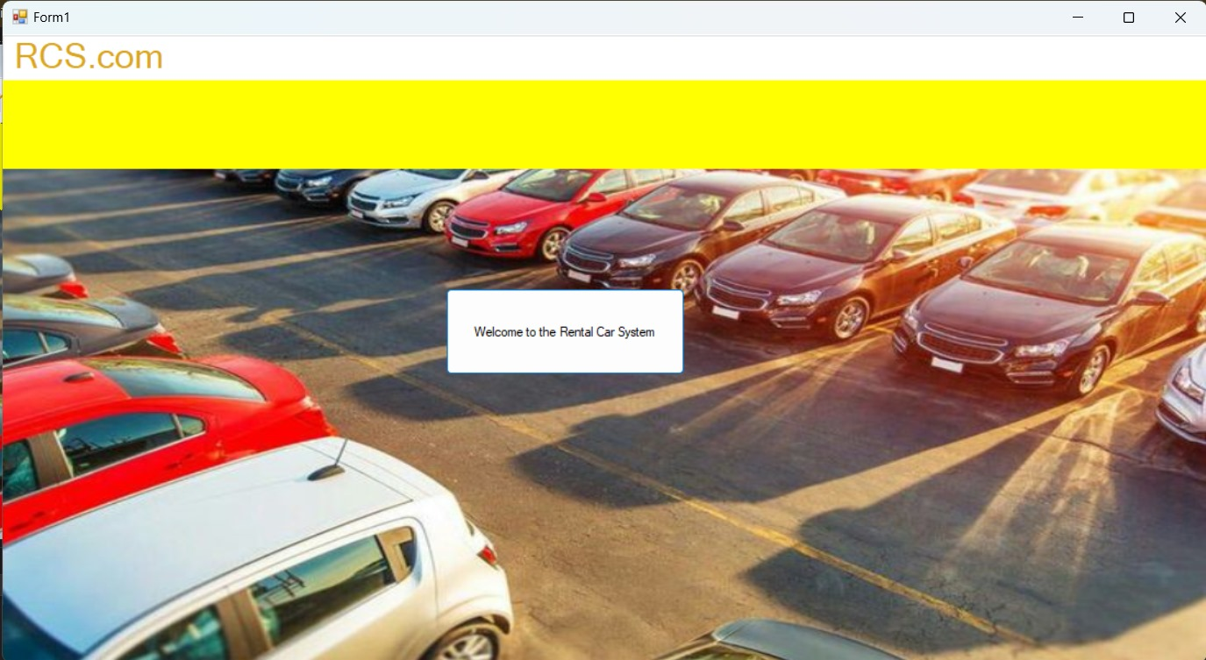
Homepage form

Slide 4
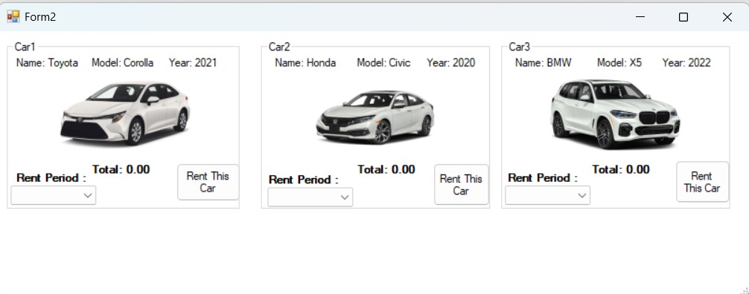
Cars form

Slide 5
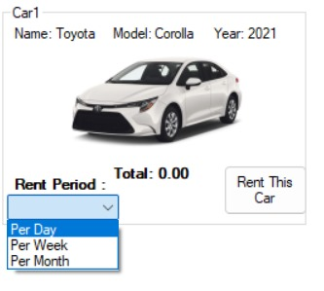
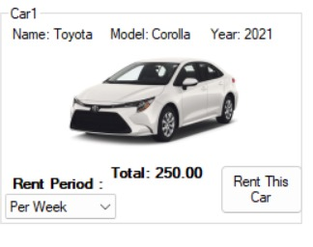
Period choosing and price display

Slide 6
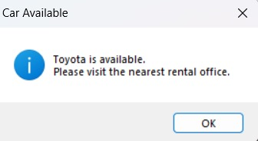
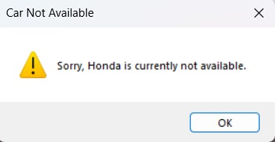
Car availability checking and program response

Slide 7
Design and layout : Form 1
panels
Background image
label
button

Slide 8
Design and layout : Form 2
GroupBox
PictureBox
Labels
ComboBox
Button

Slide 9
Database query 1:
CREATE TABLE Cars
(
CarID INT IDENTITY(1,1) PRIMARY KEY,
CarName NVARCHAR(50) NOT NULL,
Model NVARCHAR(50) NOT NULL,
CarYear INT NOT NULL,
PricePerDay DECIMAL(10,2) NOT NULL,
PricePerWeek DECIMAL(10,2) NOT NULL,
PricePerMonth DECIMAL(10,2) NOT NULL,
IsAvailable BIT NOT NULL
);

Slide 10
Database query 2:
INSERT INTO Cars
(CarName, Model, CarYear, PricePerDay, PricePerWeek, PricePerMonth, IsAvailable)
VALUES
('Toyota', 'Corolla', 2021, 40, 250, 900, 1),
('Honda', 'Civic', 2020, 45, 270, 950, 0),
('BMW', 'X5', 2022, 90, 550, 1800, 1);
SELECT CarName, Model, CarYear,
PricePerDay, PricePerWeek, PricePerMonth
FROM Cars

Slide 11
Database table
CarName | Model | Car Year | PricePerDay | PricePerWeak | PricePerMonth | IsAvailable
Toyota | Corolla | 2021 | 40 | 250 | 900 | 1
Honda | Civic | 2020 | 45 | 270 | 950 | 0
BMW | X5 | 2022 | 90 | 550 | 1800 | 1

Slide 12
Form 1 coding:
private void button1_Click(object sender, EventArgs e)
{
Form2 f2 = new Form2();
f2.ShowDialog();
}
}
}

Slide 13
Form 2 coding:
string connStr = @"Data Source=(localdb)\MSSQLLocalDB; Initial Catalog=CarRentalDB; Integrated Security=True";
- Defines the connection string used to connect to the SQL Server LocalDB database.
using (SqlConnection con = new SqlConnection(connStr))
- Creates a database connection and ensures it is automatically closed after use.

Slide 14
string sql = "SELECT IsAvailable FROM Cars WHERE CarName = @name";
- SQL query that retrieves the availability status of a car.
cmd.Parameters.AddWithValue("@name", carName);
- Safely passes the car name to the SQL query using a parameterized query.
object result = cmd.ExecuteScalar();
- Executes the query and returns a single value from the database

Slide 15
string sql = @"SELECT CarName, Model, CarYear, PricePerDay, PricePerWeek, PricePerMonth FROM Cars";
- SQL query that retrieves car details and rental prices from the database.
SqlDataReader reader = cmd.ExecuteReader();
- Reads multiple rows of data returned from the database.

Slide 16
object result = cmd.ExecuteScalar();
if (result == null)
{
MessageBox.Show("Car not found in database.");
return;
}
bool isAvailable = Convert.ToBoolean(result);
if (isAvailable)
{
MessageBox.Show(
carName + " is available.\nPlease visit the nearest rental office.",
"Car Available",
MessageBoxButtons.OK,
MessageBoxIcon.Information);
}
else
{
MessageBox.Show(
"Sorry, " + carName + " is currently not available.",
"Car Not Available",
MessageBoxButtons.OK,
MessageBoxIcon.Warning);
}

Slide 17
int index = 1;
while (reader.Read())
{
if (index == 1)
{
lblCar1Name.Text = "Name: " + reader["CarName"];
lblCar1Model.Text = "Model: " + reader["Model"];
lblCar1Year.Text = "Year: " + reader["CarYear"];
car1DayPrice = Convert.ToDecimal(reader["PricePerDay"]);
car1WeekPrice = Convert.ToDecimal(reader["PricePerWeek"]);
car1MonthPrice = Convert.ToDecimal(reader["PricePerMonth"]);
}
else if (index == 2)
{
lblCar2Name.Text = "Name: " + reader["CarName"];
lblCar2Model.Text = "Model: " + reader["Model"];
lblCar2Year.Text = "Year: " + reader["CarYear"];
car2DayPrice = Convert.ToDecimal(reader["PricePerDay"]);
car2WeekPrice = Convert.ToDecimal(reader["PricePerWeek"]);
car2MonthPrice = Convert.ToDecimal(reader["PricePerMonth"]);
}
else if (index == 3)
{
lblCar3Name.Text = "Name: " + reader["CarName"];
lblCar3Model.Text = "Model: " + reader["Model"];
lblCar3Year.Text = "Year: " + reader["CarYear"];
car3DayPrice = Convert.ToDecimal(reader["PricePerDay"]);
car3WeekPrice = Convert.ToDecimal(reader["PricePerWeek"]);
car3MonthPrice = Convert.ToDecimal(reader["PricePerMonth"]);
}
index++;

Slide 18
private void cmbCar1Period_SelectedIndexChanged(object sender, EventArgs e)
{
if (cmbCar1Period.SelectedIndex == -1)
return;
decimal total = 0;
switch (cmbCar1Period.SelectedIndex)
{
case 0:
total = car1DayPrice;
break;
case 1:
total = car1WeekPrice;
break;
case 2:
total = car1MonthPrice;
break;
}
lblCar1Total.Text = "Total: " + total.ToString("0.00");
}

Slide 19
So basically..
This form is responsible for displaying car information, handling user interactions, calculating rental prices based on user selection, and retrieving data from the database. The logic is clearly organized into methods for availability checking, price calculation, and data loading.”

Slide 20
And that concludes our presentation.
Thanks for listening!

